Slide 1
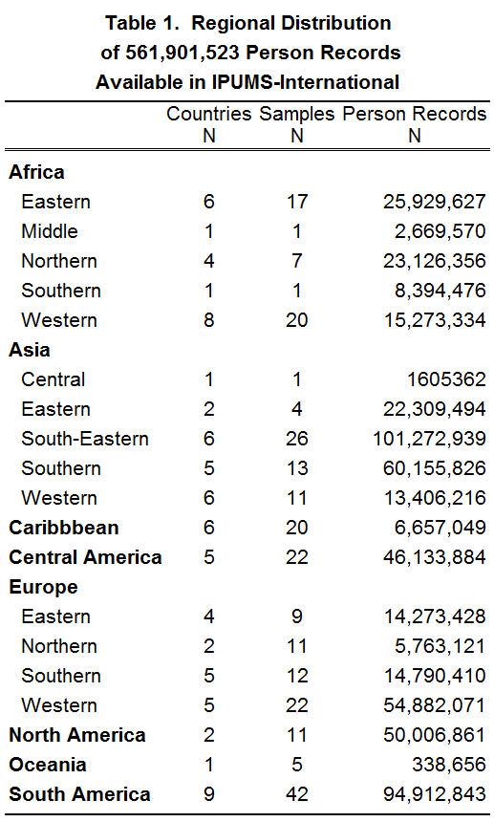
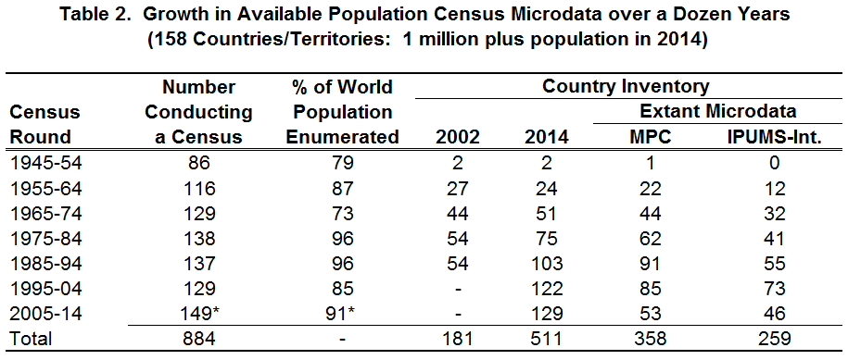
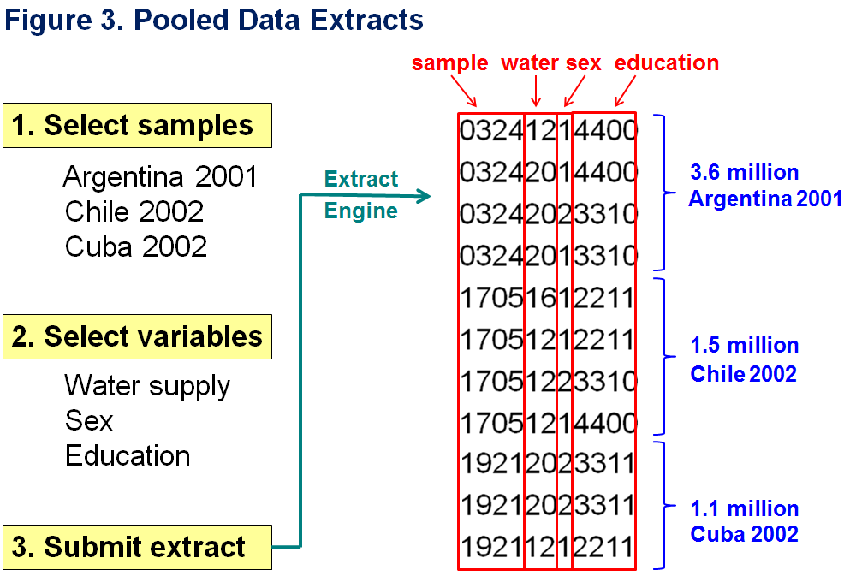
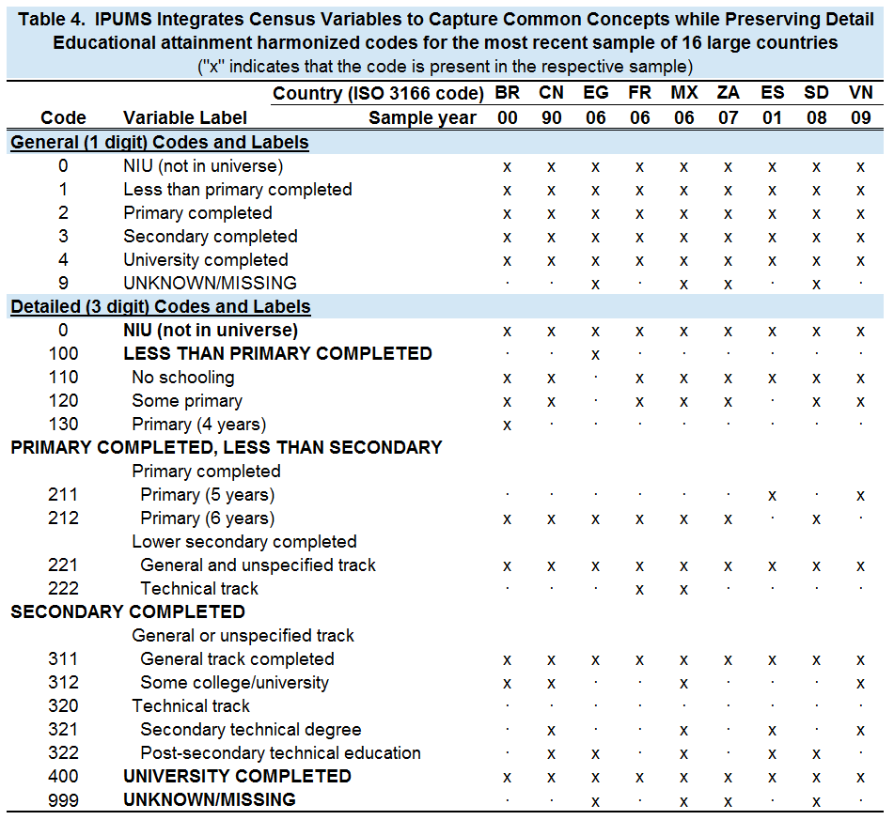
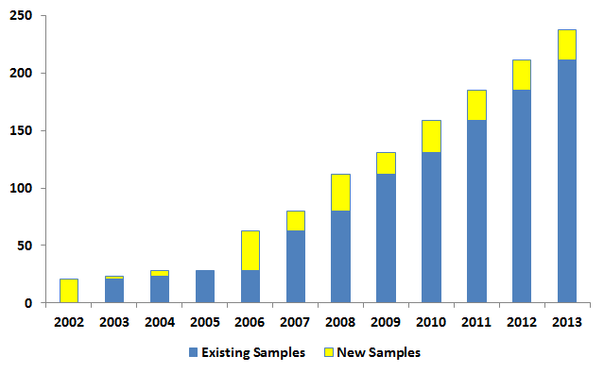
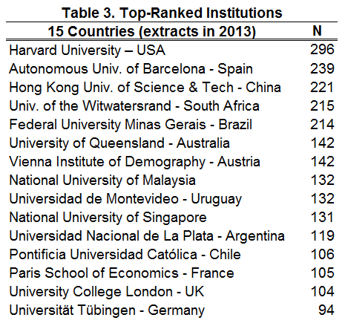
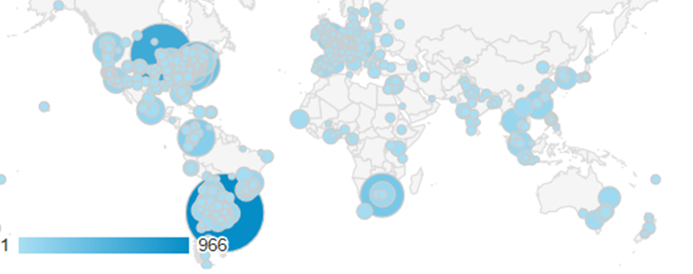
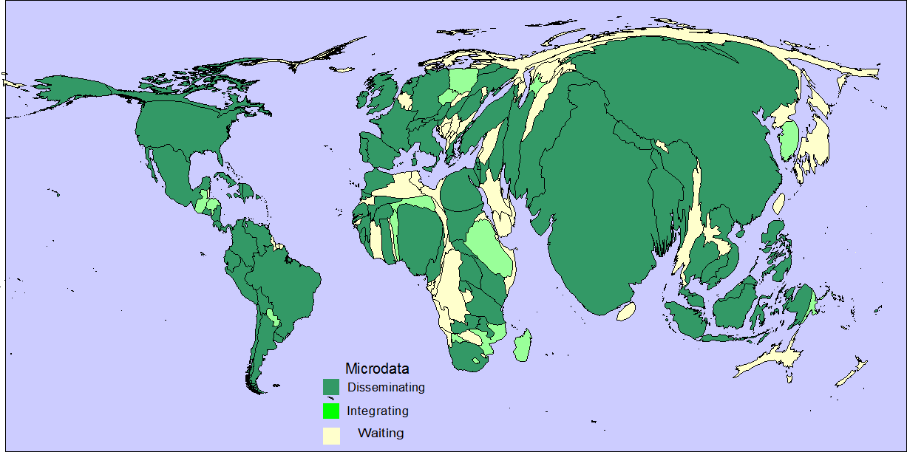
IPUMS-International Disseminates Big Census Microdata
Robert McCaa, Lara L. Cleveland and Patricia Kelly Hall, University of Minnesota
Global Census Microdata
Trans-Border Dissemination of Harmonized Census Microdata
How IPUMS Harmonizes Microdata
IPUMS-International disseminates high-precision census microdata samples to researchers world-wide free of cost. Researchers can analyze multiple census years and even multiple countries as a single dataset to conduct comparative analysis across time and space (Table 1). Population censuses became universal in the late 20th century. In the 21st century, trans-border dissemination of census microdata is becoming universal (Table 2).
Figure 2. Number of National Census Samples
Distributed by IPUMS-International by Year
-259 samples
-79 countries
-560 billion person records
-Hundreds of integrated variables
The IPUMS disseminates pooled extracts in a single dataset, custom-tailored to the precise research needs of the user (see Figure 3). Each user-generated extract contains only the requested microdata accompanied by the corresponding set of DDI (Document Data Initiative) compatible metadata and a codebook suitable for constructing a system file in SPSS, SAS or STATA. Interactive metadata and original source material in the official language are also available on the website.
Global Research Infrastructure
For social scientists, trans-border access to the world’s microdata is essential for conducting research in their country of birth as well for engaging in comparative, cross-national research.
Global Reach of IPUMS-International Data Users
Data Sources and Bibliography
The global reach of the IPUMS-International project is evident in this “Google-Analytics” map of recent traffic to the website (Figure 4). Internet traffic from 125 countries and territories and more than 1,400 cities is depicted on the map. Intense traffic was sparked by the release of the integrated sample of the 2010 census of Argentina. For the 45 days following the release, Buenos Aires ranked first, generating more traffic even than Minneapolis, the home of IPUMS-International. Thanks to the Instituto Nacional de Estadística y Censos (INDEC) of Argentina for making the sample available without delay.
Data Sources: Original census data are contributed to the IPUMS-International project by National Statistical Offices in partner countries. The data are harmonized and distributed by IPUMS-International under licensure agreements with each country represented.
Select Bibliography:
Cleveland, L.; McCaa, R.; Ruggles, S.; and Sobek, M. 2012. “When Excessive Perturbation Goes Wrong and Why IPUMS-International Relies Instead on Sampling, Suppression, Swapping, and Other Minimally Harmful Methods to Protect Privacy of Census Microdata, " in J. Domingo-Ferrer and I. Tinnirello (Eds.): Privacy in Statistical Data 2012, LNCS Vol. 7556.
Esteve, A. and M. Sobek. 2003. “Challenges and methods of international census harmonization .” Historical Methods 36: 66-79
McCaa, R. and A. Esteve. 2005. “IPUMS-Europe: Confidentiality measures for licensing and disseminating restricted access census microdata extracts to academic users,” Joint UNECE/Eurostat Work Session on Statistical Confidentiality, Geneva, Nov. 9-11
McCaa, R. and S. Ruggles. 2002. “The census in global perspective and the coming microdata revolution.” Scandinavian Population Studies 13: 7-30
Ruggles, S. 2014. “Big Microdata for Population Research,” Demography 51:287-297.
Sobek, M., L.L. Cleveland, S. Flood, M. King, P.K. Hall, S. Ruggles, and M. Schroeder. 2011. “Big Data: Large-Scale Historical Infrastructure from the Minnesota Population Center.” Historical Methods 44: 61-68
Figure 1 (cartogram). IPUMS-International Disseminates “Big Data”
Data currently are available for 82 percent of the world’s population
Figure 4. Internet traffic to the IPUMS-International website, August 1- Sep 18, 2013. Source: Google Analytics, City Statistics: n=12,360

